Slide 1
Packages in Java

Slide 2
Packages: Putting Classes Together
One of the main features of OOP is its ability to reuse the code already created.
One way is to inheritance – limited to reusing the classes within the program.
What if we need to use classes from other programs?
This can be accomplished in java by using “Packages”
Packages are similar to “class libraries” in other languages.

Slide 3
Packages in java
Packages are java’s way of grouping a variety of classes and/ or interfaces together.
The grouping is usually done according to functionality.
Packages act as containers for classes.
Examples of packages:
lang, awt, util, applet, javax, swing, net, io, sql,etc.

Slide 4
Advantages of packages
The classes contained in the package can be easily reused.
Two classes in two different packages can have the same name.
Package provide a way to hide classes thus preventing other programs or packages from accessing classes that are for internal use only.
Provide a way of separating “design” from “coding”.

Slide 5
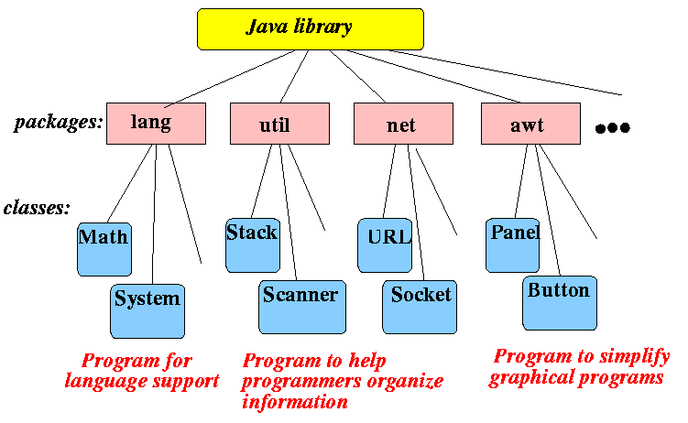
Different Types of Packages:
There are two types of packages in Java:
Built-in packages
User-defined packages

Slide 6
Built-in packages
They are also called as Java API Packages.
Java API provides a large number of classes grouped into different packages according to functionality.

Slide 7
Java API Packages
Java.lang: lang stands for language.
This package has primary classes and interfaces essential for developing a basic Java program.
It consists of wrapper classes , String, StringBuffer, StringBuilder classes to handle strings, thread class.
Java.util: util stands for utility.
This package contains useful classes and interfaces like Stack, LinkedList, Hashtable, Vector, Arrays, Date and Time classes.
Java.io: io stands for input and output.
This package contains streams. A stream represents flow of data from one place to another place. Streams are useful to store data in the form of files and also to perform input-output related tasks.

Slide 8
Java API Packages
Java.awt: awt stands for abstract window toolkit.
This helps to develop GUI(Graphical user Interfaces). It consists of , classes which are useful to provide action for components like push buttons, radio buttons, menus etc.
Java.net: net stands for network.
Client-Server programming can be done by using this package. Classes related to obtaining authentication for network, client and server to establish communication between them are also available in java.net package.
Java.applet:
applets are programs which come from a server into a client and get executed on the client machine on a network. Applet class of this package is useful to create and use applets.

Slide 9
Using System packages
The package name java contains package awt, which contains various classes required for implementing GUI.
Hierarchical representation of java.awt package.
javajavajava
java
awt
Color
Graphics
FONT
Images

Slide 10
Using System Packages
Classes stored in packages can be accessed in two ways
Use the fully qualified class name of class that we want to use. This is done by using package name containing the class name using dot operator.
Example :
import java.awt.Color;
In many situations we might use class name in number of places in the program or we may like to use many classes of that package then-
Example:
import java.awt.*;

Slide 11
Naming Conventions
Package names are written in lower case to avoid conflict with the names of classes or interfaces.
All class names begin with uppercase letters and methods with lower case letters.
double y=java.lang.Math.sqrt(x);
Class name
Package Name
Method name

Slide 12
User-Defined packages:
The users of the Java language can also create their own packages.
They are called user-defined packages.
User-defined packages can also be imported into other classes and used exactly in the same way as the Built-in packages.

Slide 13
Creating Packages
package packagename; //to create a package
package packagename.subpackagename;
//to create a sub package within a package.
e.g.: package pack;
The first statement in the program must be package statement while creating a package.
While creating a package except instance variables, declare all the members and the class itself as public then only the public members are available outside the package to other programs.

Slide 14
A program to create a package pack with Addition class.
package pack;
public class Addition
{
private double d1,d2;
public Addition(double a, double b) {
d1 = a;
d2 = b; }
public void sum()
{ System.out.println ("Sum is : " + (d1+d2) ); }
}
Compile and save .java and .class file in pack directory (folder).

Slide 15
Using Package
Write a java program to use the already created package.
import pack.Addition;
class Use
{
public static void main(String args[])
{
Addition A=new Addition(10.5,5.2);
A.sum();
}
}
Compile and run Use.java program

Slide 16
Steps to create a package in java
Declare the package at the beginning of a file using form
package packagename;
Define a class that is be put in the package and declare it public.
Create a subdirectory under the directory where main source files are stored.
Store the listing as the classname.java file in the subdirectory created.
Compile the file. This creates .class file in the subdirectory.

Slide 17
Access Protection
 | Public | Protected | Friendly | Private protected | Private
Same class | Yes | Yes | Yes | Yes | Yes
Subclass in same package | Yes | Yes | Yes | Yes | No
Other classes in same package | Yes | Yes | Yes | No | No
Subclasses in other package | Yes | Yes | No | Yes | No
Non subclasses in other package | Yes | No | No | No | No

Slide 18
Static Import
Eliminates the need of qualifying a static member with the class name.
The static import declaration is similar to that of import.
We can use static import statement to import static members from classes and use them without qualifying class name.
import static package-name.sub-package-name.class-name.Staticmember-name;
Or
import static package-name.subpackage-name. class-name.*;

Slide 19
Program Without Static Import
import java.lang.Math.*;
class Test{
public static void main(String[] args)
{
System.out.println(Math.sqrt(4));
System.out.println(Math.pow(2, 2));
System.out.println(Math.abs(6.3));
}
}

Slide 20
Program With Static Import
import static java.lang.Math.*;
class Test2 {
public static void main(String[] args)
{
System.out.println(sqrt(4));
System.out.println(pow(2, 2));
System.out.println(abs(6.3));
}
}

